Slide 1
Indexing
CS 4750
Database Systems
[Silberschatz, Korth, Sudarshan, “Database System Concepts,” Ch.14] [H. Garcia-Molina, J.D. Ullman, J. Widom, Database Systems: The Complete Book, Ch.14]

Slide 2
Course Announcements
Phase 4 due on 03/31
Course Calendar: https://docs.google.com/spreadsheets/d/1QEXtib2QHE9eCnLVg2DY2obcndftr54ly-EiPqGJQNk/edit?gid=0#gid=0

Slide 3
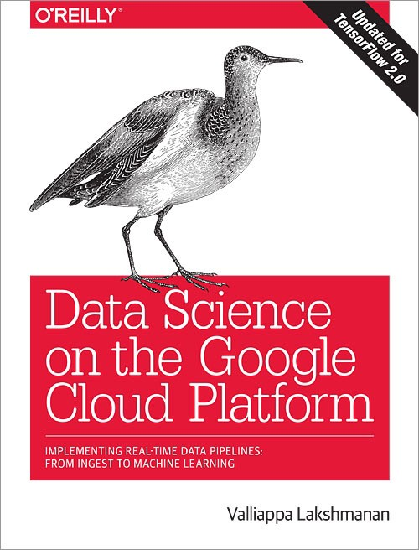
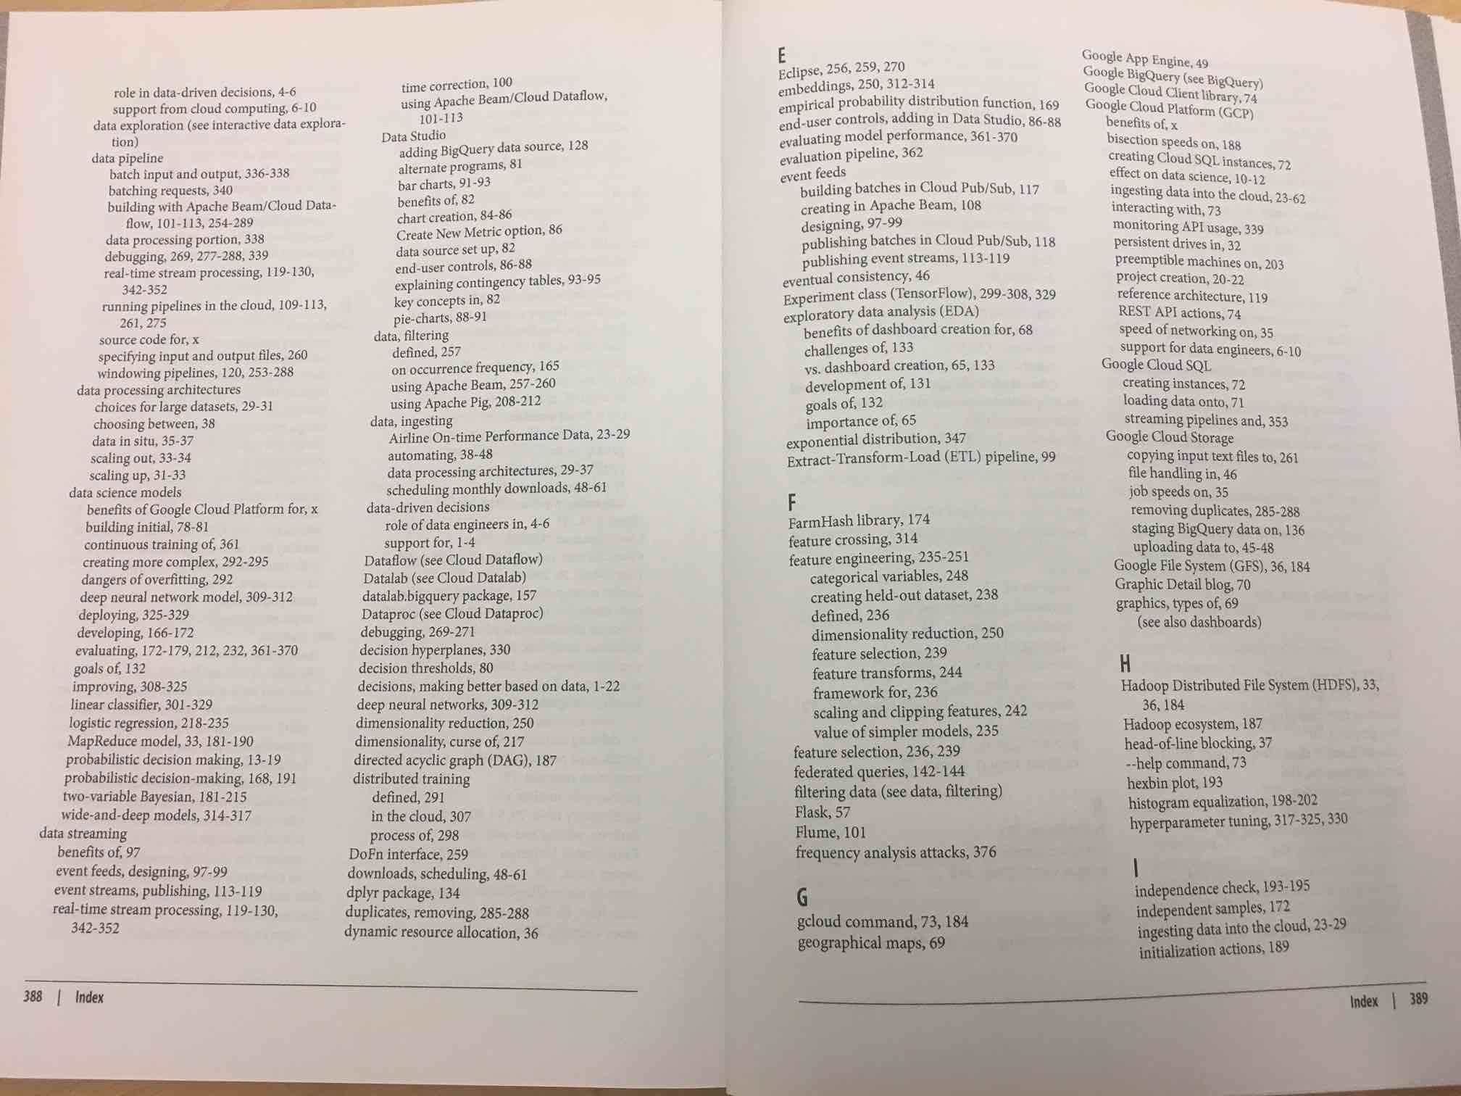
Indexing in a Book
Find information about “Google Cloud SQL” from
Some book
Look for the keywords in the index
Find the pages where the words occur
Read the pages to find the information
Sorted order

Slide 4
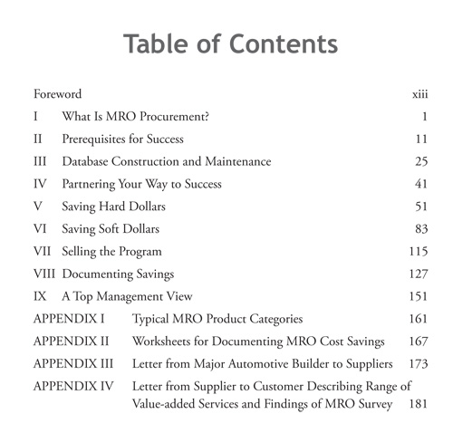
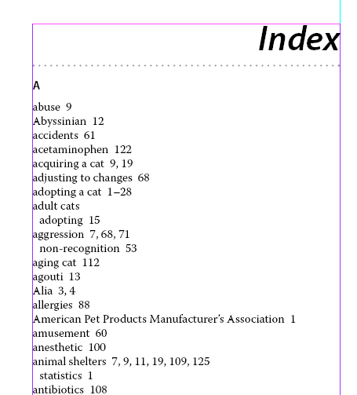
What is Indexing?
A “labeled” pointer to an (a collection of) item that satisfies some common property
Examples in the Real World?

Slide 5
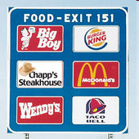

What is Indexing?
A “labeled” pointer to an (a collection of) item that satisfies some common property
Examples in the Real World?

Slide 6

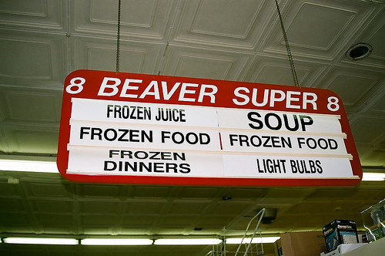
What is Indexing?
A “labeled” pointer to an (a collection of) item that satisfies some common property
Examples in the Real World?

Slide 7
Indexing in Database
Example: Find 2nd year students who have taken < 45 credits
There might be 10,000 tuples in students relation.
SELECT *
FROM students WHERE year=2 AND
Get all 10,000 tuples and test the condition of the WHERE clause on each tuple?
credits < 45;
Find which disk block the corresponding record resides
Fetch the disk block
Get the appropriate student records
Is there a way to get only the tuples from 2nd year students and then test each of them to see if the credits match?

Slide 8




Indexing in Database
Indexing = data structure technique to optimize the performance of a database by minimizing the number of disk accesses required when query is processed
Basic algorithm to search – linear. However, complex search queries (especially with joins) impacts performance
Indexing helps improve performance
Common structure used by a typical DBMS is B+ tree
The key for the index can be any attribute or set of attributes and need not be the key for the relation on which the index is built.
Rule of thumb: Create an index on the attribute that is used frequently in the search

Slide 9
Indexing in Database
An index takes a value for some field(s) and finds records with the matching value quickly
File containing a list of indices
Blocks holding records
Matching records
value
index
Search key
Data reference
May be primary key or candidate key of the table (sorted order)
Hold the address of the disk block where the key value can be found
General index record (structure)
“Search key” (or “key”) = Field(s) on whose values the index is based

Slide 10


Selection of Indexes
An index on an attribute may speed up the execution of those queries in which a value, or range of values, is specified for that attribute, and may speed up joins involving that attribute.
On the other hand, every index built for one or more attributes of some relation makes insertions, deletions, and updates to that relation more complex and time-consuming.
Database designers must analyze the trade-off

Slide 11
Which Indexing Technique to Use
Aspects that must be considered:
Access types
Finding records with a specified attribute value (search key), or
Finding records with attribute value based on a specified range
Access time
Time needed to find a particular data item or set of data items
Insertion time
Time to find the place to insert + time to insert a new data item
+ time to update the index structure
Deletion time
Time to find the data item to be deleted + time to delete the data + time to update the index structure
Space overhead
Space occupied by an index structure (vs. performance)

Slide 12
Types of File Organization Mechanism
Sequential file organization (or Ordered index)
Indices based on sorted ordering of the values
Generally fast
Basic / traditional structure that most DBs use
Hash file organization (or Hash index)
Indices based on a uniform distribution of values across a range of buckets
Hash function determines a value assigned to a bucket

Slide 13
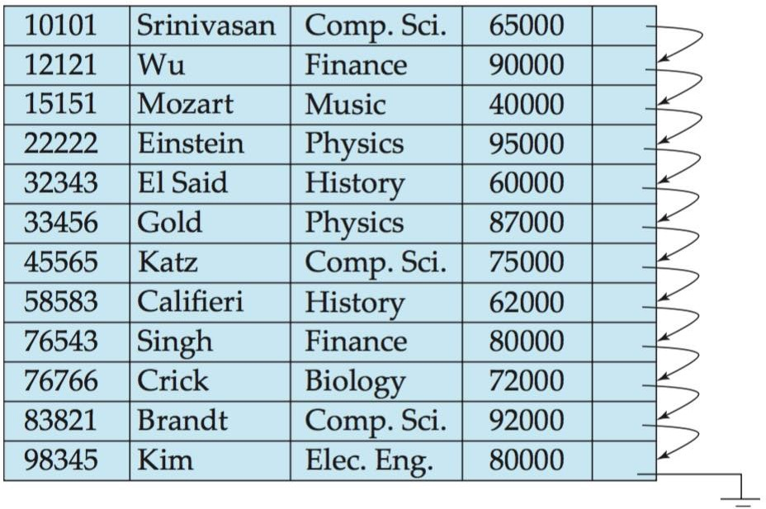
Example: Sequential File
Instructor
Instructor records
The records are stored in sorted order of instructor’s ID (used as a search key)
Search key defines the sequential order of the file
[Ref: Figure 11.1, Silberschatz, Korth, Sudarshan, “Database System Concepts,” 6th Ed., page 477]

Slide 14
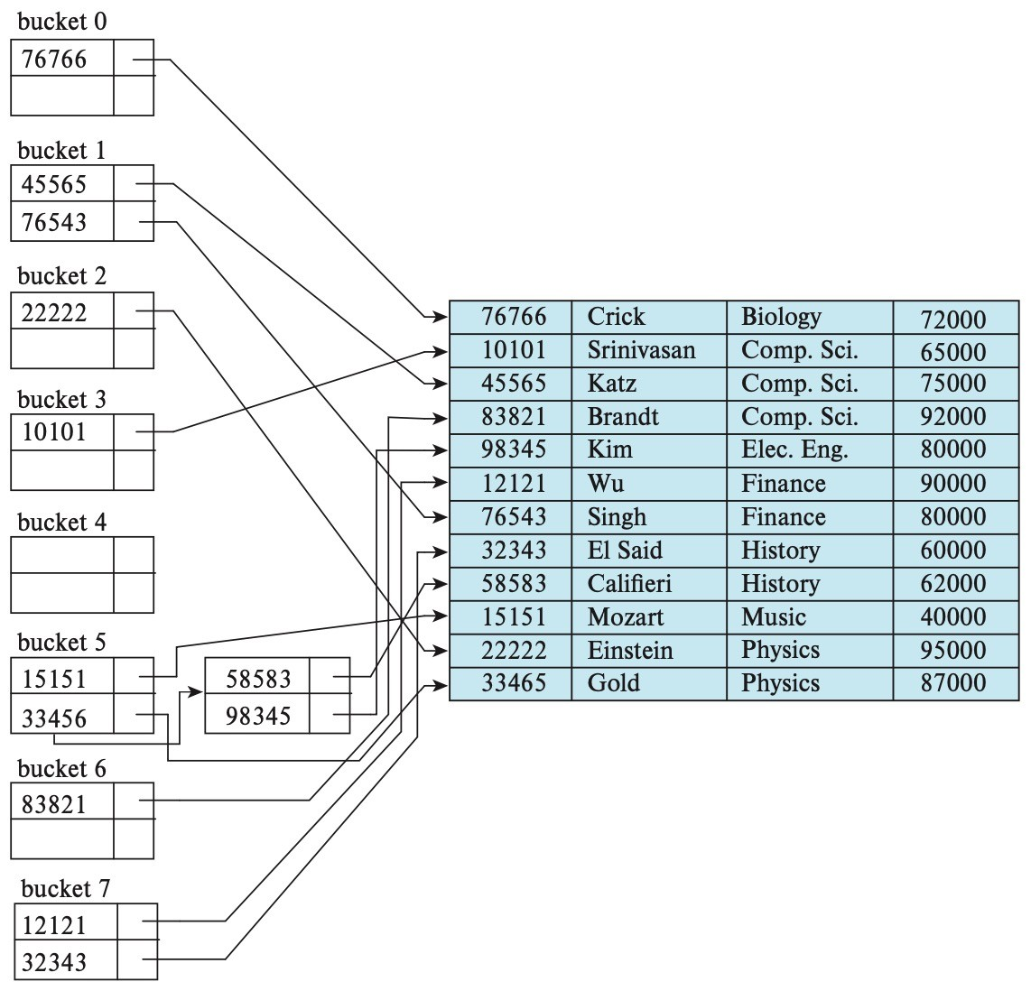
Example: Hash File
Bucket index,
B = size of the bucket
Search key
Hash function
[0,1,2,..,B-1]
0
1
2
3
(key, pointer) (key, pointer) (key, pointer)
B-1
Bucket array
[Ref: based in part on Figure 24.6, Silberschatz, Korth, Sudarshan, “Database System Concepts,” 7th Ed., page 1191]

Slide 15
Ordered Index Structures
A file may have several indices, on different search keys
Primary index (or clustered index)
Search key defines the sequential order of the file
Search key of a clustering index is often the primary key (but not necessarily so)
Secondary index (or unclustered index)
Search key specifies an order different from the sequential order of the file
Use an extra-level of indirection to implement a secondary index, containing pointers to all the records

Slide 16


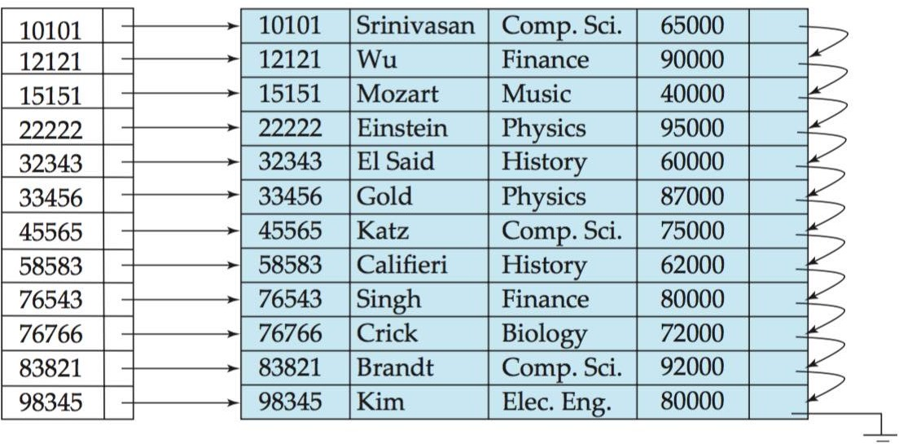
Example: Primary Index
Search key defines the sequential order of the file
Fast but can result in unnecessary indices and big space needed
Instructor
[Ref: Figure 11.2, Silberschatz, Korth, Sudarshan, “Database System Concepts,” 6th Ed., page 478]

Slide 17


Example: Secondary Index
Search key specifies an order different from the sequential order of
the file
Improve performance of queries on non-primary keys but impose overhead
Comp. Sci. Finance Music Physics
Need an extra-level to implement
Instructor
[based in part on Figure 11.6, Silberschatz, Korth, Sudarshan, “Database System Concepts,” 6th Ed., page 484]

Slide 18
Ordered Index
Created on the basis of the key of the table
Ordered file with fixed, two fields
Search key Data reference
May be primary key or candidate key of the table
(sorted order)
Hold the address of the disk block where the key value can be found
Unique to each record (i.e., 1:1 mapping)
Since primary keys are stored in sorted order, the performance of the search operation is quite efficient
Two types:
Dense index
Sparse index

Slide 19


Dense Index
A record is created for every search key value
Need more space to store index records
Example: a search key is a primary key
Find instructor with ID “58583”
Instructor
A primary index that is dense on a primary-key, ordered table is redundant (requiring unnecessary spaces)
Instructor file is sorted by
instructor’s ID
(every search key valued)
Point to the real record on the disk
[Ref: Figure 11.4, Silberschatz, Korth, Sudarshan, “Database System Concepts,” 6th Ed., page 480]

Slide 20


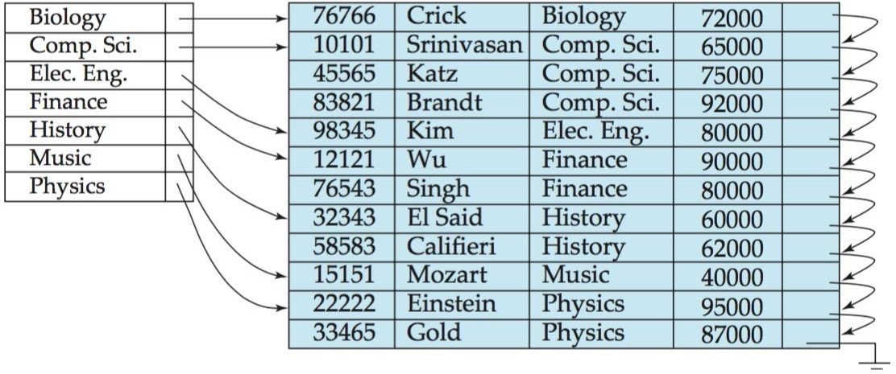
Dense Index
Support range queries
Example: a search key is not a primary key
Find a history instructor with ID “58583”
Pointer points to the first data record with the search-value. The rest of the records are sorted on the same search key
Instructor file is sorted on the search key
dept-name
Follow the pointer directly to the first record,
then follow the pointer in that record to locate the next record in search key order until the desired record is found
Instructor
[Ref: Figure 11.4, Silberschatz, Korth, Sudarshan, “Database System Concepts,” 6th Ed., page 480]

Slide 21
Dense Index: Lookup
Given a search key K, the index is scanned
When K is found, the associated pointer to the data file recorded is followed and the block containing the record is read in main memory
When dense indexes are used for non-primary key, the minimum value is located first
Consecutive blocks are loaded in main memory until a search key greater than the maximum value is found
The index is usually kept in main memory. Thus one disk I/O has to be performed during lookup
Since the index is sorted, a binary search can be used.
If there are n search keys, at most log₂n steps are required to locate a given search key
Query-answering using dense indices is efficient

Slide 22
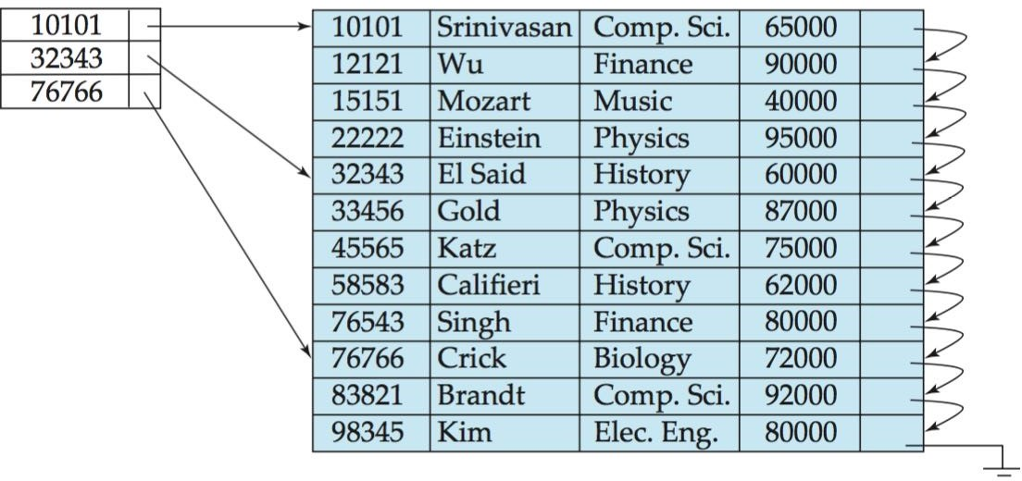


Sparse Index
Used when dense indices are too large
One key-pointer pair per data block
Can be used only if the relation is stored in sorted order of the search key
Find instructor
with ID “22222”
Start with search-key value less than or equal to the desired search value,
then linear search
Instructor
[Ref: Figure 11.3, Silberschatz, Korth, Sudarshan, “Database System Concepts,” 6th Ed., page 479]

Slide 23
Sparse Index: Lookup
Given a search key K,
Search the sparse index for the greatest key ≤ K, using binary search
Retrieve the pointed block to main memory to look for the record with search key K (linear search vs. binary search)
The index is usually kept in main memory. Thus one disk I/O has to be performed during lookup
Efficient in space but may require more computation time due two binary searches
Search on the sparse index
Search on the retrieved data block

Slide 24
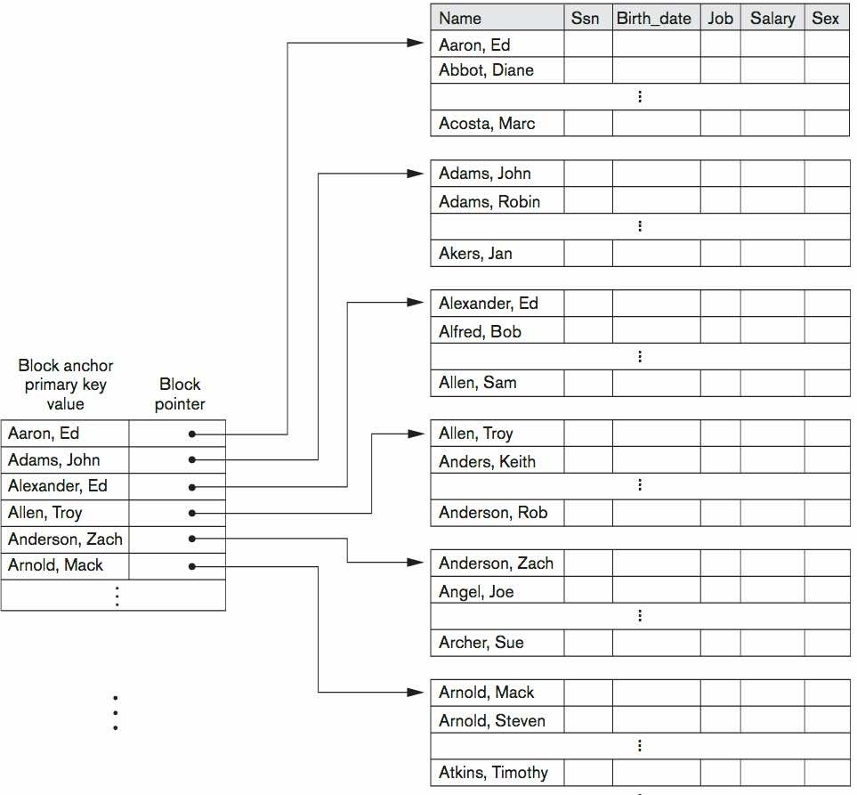
Dense Index vs. Sparse Index
A primary index that is dense on an ordered table is redundant
Thus, a primary index on an ordered table is always sparse
Dense indices are faster in general
Sparse indices require less space and impose less maintenance for insertions and deletions
Try to have a sparse index with one entry per block
Try to keep index size small
[Ref: Figure 18.1, Elmasri Navathe, “Fundamentals of Database Systems,” 6th Ed., page 634]

Slide 25


How to Implement: Use B+ Trees
As the database grows (and the index file grows), performance degrades. Reorganization is costly
Solution: use B+ tree to maintain indices
B+ Tree
A tree-like file structure
Links nodes with pointers
Balance sorted tree, allowing fast search and maintenance without overflow pages
Has exactly one root, bounded by leaves
Has unique path from root to each leaf; all paths are equal length
Store keys only at leaves, references in other/internal nodes
Guides key search via the reference values, from root to leaves
Balance – same length on every path from root to leaves
Extensible – number of pointers (n) at any given node

Slide 26
B+ Tree: Node
Nodes: root, internal node, or leaf node
Each node is exactly one disk page (“page” and “node” are used interchangeably)
Contain n pointers and (n-1) key values
n = 5
root
(n-1) = 4 key values
25
50
75
<25
25≤key<50
75≤key< …
50≤key<75
leaves
5 10 15 20 25 30 50 55 60 70 75 80 85 90
100% data direct (1:1) mapping to actual data
DB

Slide 27
B⁺-Tree Index Files
A B⁺-tree is a rooted tree satisfying the following properties:
It is a balanced tree
All paths from root to leaf are of the same length
Special cases:
If the root is not a leaf, it has at least 2 children.
If the root is a leaf (that is, there are no other nodes in the tree), it can have between 0 and (2d–1) values
Each node should fit in a block

Slide 28

B+ Trees Basics
Internal node:
Leaf:
30 |  | 120 |  | 240
[X , 30)
[30, 120)
[120, 240)
[240, Y)
40 |  | 50 |  | 60
next leaf
40
50
60

Slide 29
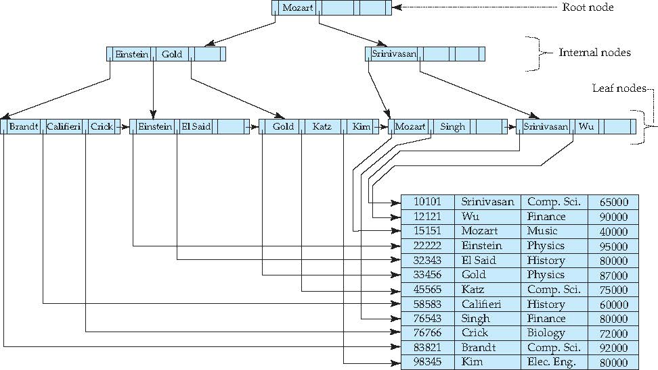
Example of B⁺-Tree

Slide 30
Searching a B+ Tree
Point queries with exact key values:
Start at the root
Proceed down, to the leaf
Range queries:
As above
Then sequential traversal on leafs
Select name
From people
Where age = 25
Select name
From people
Where 20 <= age
and age <= 30

Slide 31
B+ Tree Example
Select name
From person
Where age = 30
(Where age >=30)
(Where 20<=age and age <=30)
Root (d=1)
d = 2
80
20 |  | 60
100 |  | 120 |  | 140
10 |  | 15 |  | 18
20 |  | 30 |  | 40 |  | 50
60 |  | 65
80 |  | 85 |  | 90
10
15
18
20
30
40
50
60
65
80
85
90

Slide 32
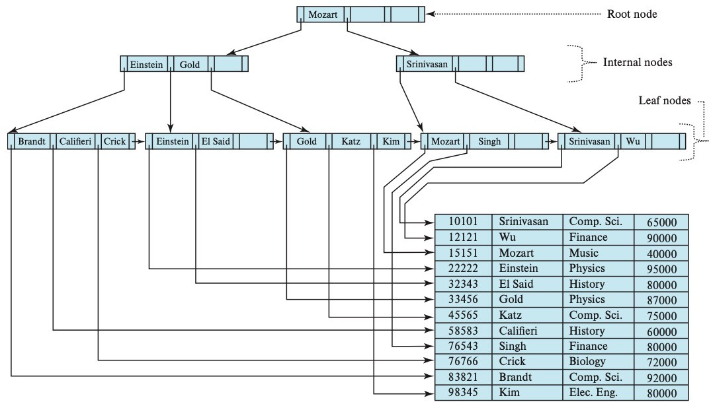
Example: B+ Tree
[Ref: Figure 14.9, Silberschatz, Korth, Sudarshan, “Database System Concepts,” 7th Ed., page 636]

Slide 33




Low n vs. High n
Small value for n -- Tall and thin B+ tree
Advantage: Good consistent performance
Equal depth of tree → constant lookup time
Disadvantage: High overhead when insert/delete
Need to reorganize up and down the tree
Large value for n -- Short and wide B+ tree
Advantage: Low overhead
Disadvantage: Performance varies
Read-heavy DB → consistent time → low n
Read/Write-mix DB → less overhead → high n

Slide 34




Advantages and Disadvantages
Index-sequential files:
Disadvantage:
Performance degrades as sequential file grows because many overflow blocks are created
Periodic reorganization of entire file is required
B+ Tree indices are alternatives to index sequential files
B+ Tree index file:
Advantage:
B+ Trees are used extensively in all DBMS
Automatically recognize itself with small, local changes (when insert or delete data)
Range queries on indexed attributes are fast
Disadvantage:
Extra insertion deletion overhead, space overhead

Slide 35
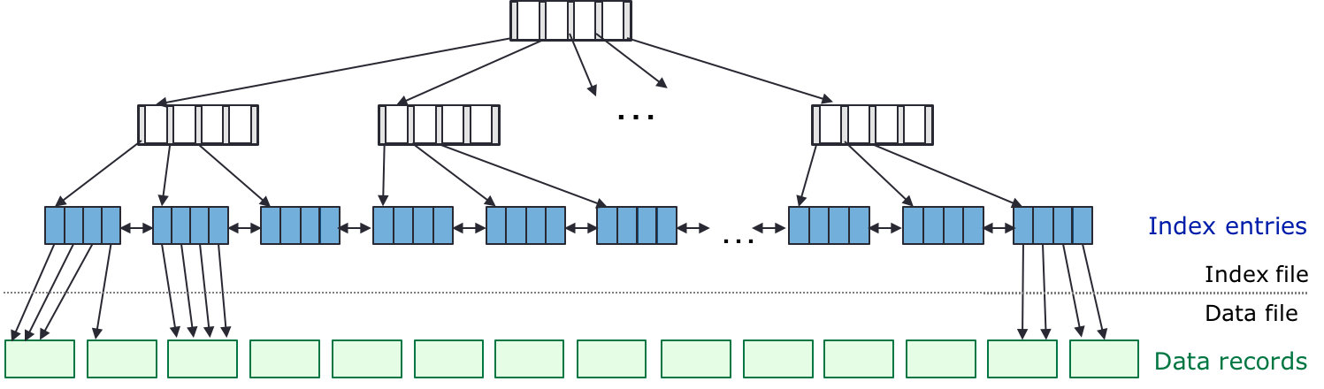
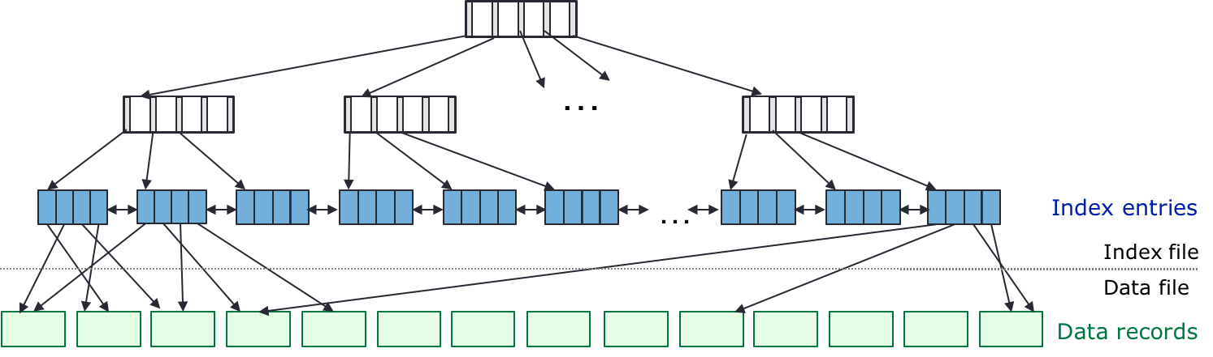
Clustered vs. Unclustered Index
revisit
Clustered Index
Records close in index are close in data
Unclustered Index

Slide 36
Cost of Disk I/O Operations
Assume a disk block holds 4 tuples of a relation. To find tuples associated with key values 40 – 85
Without an index, need sequential scanning
Estimated cost = # blocks scanned
d1 | d2 | d3 | d4 | d5 | d6 | d7 | d8
 |  |  |  |  |  |  |  | d9 |  | d10 |  | d11 |  | d12 |  | d13 |  | d14 | …
Sequential data file

Slide 37
Cost of Disk I/O Operations
Assume a disk block holds 4 tuples of a relation. To find tuples associated with key values 40 – 85
Use clustered index, index and data are sorted the same way
Estimated cost = selectivity estimate x #blocks
Index file
 | 80
 | 20 |  | 60
 | 120 |  | 140
10 | 15 | 18
20 | 30 | 40
60 | 65
80 | 112
120 | 135 | 138
140 | 148
d1
d2
d3
d4
d5
d6
d7
d8
d9
d10
d11
d12
d13
d14
…
Sequential data file

Slide 38
Cost of Disk I/O Operations
Assume a disk block holds 4 tuples of a relation. To find tuples associated with key values 40 – 85
Use unclustered index, index and data are sorted differently
Estimated cost = selectivity estimate x #tuples
Worse case: read a different block every time. Thus, choose key(s) carefully
Index file
 | 80
 | 20 |  | 60
 | 120 |  | 140
10 | 15 | 18
20 | 30 | 40
60 | 65
80 | 112
120 | 135 | 138
140 | 148
d1
d2 d3
d4
d5 d6 d7 d8
d9
d10
d11
d12
d13
d14
…
Sequential data file

Slide 39
Another Scenario
Supposed we know the following #blocks = 100
#tuples = 10000
Using an unclustered index in the wrong scenario can lead to low performance
X = Selectivity estimate (~proportion of tuples matching the selection) of a given query = 0.1
No index (full sequential scan) Unclustered index
Cost
= #blocks Cost
= 100
= X * #tuples
= 0.1 * 10000
= 1000
Full sequential scan is a better option when
Selectivity is high (many tuples match the selection), or
Ratio between #tuples:#blocks is high

Slide 40


Wrap-Up
The existence of an index on an attribute
May speed up the execution of the queries (in which a values or a range of values is specified for that attributes), and
May speed up joins involving that attribute.
Every index built for one or more attributes of some relation makes insertions / deletions / updates to that relation more complex and time consuming.
When creating indices, transactions that will be executed must be taken into account.
Read-heavy DBs – can index a lot (if space allows)
Write-heavy DBs – index sparingly (take a balanced approach) Write-only DBs – one or no index
Create indices to match expected query workload

